Slide 1

软件工程专业英语
计算机科学学院
School of Computer Science
Unit 5：Designing the System

Slide 2
Outline
Part 1, Dialogue: Software Design
Part 2, Translating: Software Design

Slide 3
Part 1, Dialogue: Software Design
Main content
主要讨论了软件设计阶段的工作任务
1）构架设计：选择合适的构架类型（architectural style）
2）详细设计
系统分解：基于选定的构架，如何将前一阶段获得的分析模型（analysis model）分解成子系统（subsystems）
用户接口设计
组件级设计：算法流程、数据结构

Slide 4
Sharon: Having completed the analysis modeling and requirements specification of the system, we can progress further!
Kevin: Yes, now let's have a discussion on our generic task set in the design process.
Jason: We will move from a “big picture” view of the software to a more narrow view that defines the details required to implement this system. The process begins by focusing on architecture, I think.
a/an adj. view of
a big/narrow picture view of
a bird’s-eye view of
a mistaken/skeptical (怀疑的) /simplistic/romantic view of
鉴于，由于，考虑到
in view of/in consideration of/in the light of/
Notes:
skeptical 英 [ˈskeptɪkl] 美 [ˈskeptɪkl] adj.怀疑的

Slide 5
Sharon: What do you mean?
Jason: Using the analysis model we constructed last week, we need to select an architectural style that is appropriate for our software.
Kevin: After that, we can partition the analysis model into design subsystems and allocate these subsystems within the architecture.
partition…into… 分割；划分
partition 分区
"Client/ Server" refers to software designs that partition applications into two or more independent, communicating modules.
客户机/服务器是指软件设计，将应用程序分成两个或两个以上独立的、能通信的模块。
分割；划分
divide … into …
separate … into …
decompose … into …
分组；分类
group … into …
category … into …
classify … into …

Slide 6
Jason: In the detailed design phase, we must be certain that each subsystem is functionally cohesive, and design subsystem interfaces first, and then allocate analysis classes or functions to each subsystem.
Kevin: Additionally, it is an important factor for successful software to have a user interface appreciated by its users, particularly for business software like ours.
Jason: Sharon is a competent art designer.
Sharon: I'll do my best.
Kevin: We will collaborate [kəˈlæbəreɪt] to specify action sequences based on user scenarios and help Sharon to create a behavioral [bɪ'heɪvjərəl] model of the interface.
Sharon: Ok, next, I will define interface objects and control mechanisms and beg you to review and revise as required.
cohesive [koʊˈhiːsɪv] adj. 结成一个整体的; 内聚的
competent [ˈkɒmpɪtənt] adj. 足以胜任的; 有能力的; 称职的

Slide 7
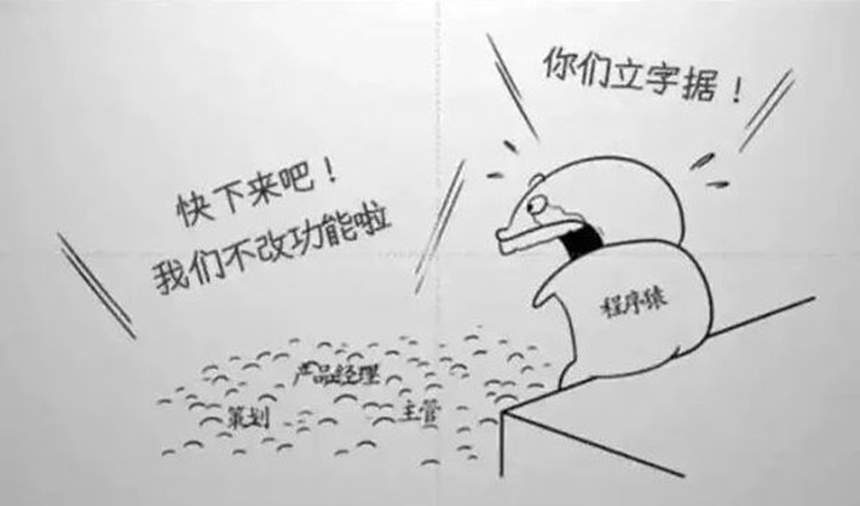
终端用户不知道该如何使用你开发的软件
论software design的重要性

Slide 8
Outline
Part 1, Dialogue: Software Design
Part 2, Translating: Software Design

Slide 9
The 1st paragraph
Design is defined in [IEEE610.12-90] as both “the process of defining the architecture, components, interfaces, and other characteristics of a system or component” and “the result of that process.” Viewed as a process, software design is the software engineering life cycle activity in which software requirements are analyzed in order to produce a description of the software's internal [ɪnˈtɜːrnl] structure that will serve as the basis for its construction. … …
从句修饰description
从句修饰activity
作为一个过程来看，软件设计是一项软件工程生命周期活动，其中，软件需求被分析以产生软件内部结构的描述，它将作为软件构建的基础。
从句修饰structure

Slide 10
The 1st paragraph
… … More precisely, a software design (the result) must describe the software architecture — that is how software is decomposed and organized into components — and the interfaces between those components. It must also describe the components at a level of detail that enable their construction.
插入语，作补充说明
更确切地讲，软件设计（的结果）必须描述软件体系结构— 即软件如何被分解和组织成组件 — 以及组件之间的接口。软件设计也必须在使其能够构建的详细级别上描述组件。

Slide 11
The 2nd paragraph
Software design plays an important role in developing software: it allows software engineers to produce various models that form a kind of blueprint of the solution to be implemented. We can analyze and evaluate these models to determine whether or not they will allow us to fulfill the various requirements. We can also examine and evaluate various alternative solutions and trade-offs. … …
trade-off 权衡; 交易; 折中
1. This white paper described the need for SELT and discussed the trade-off between accuracy and implementation complexity.
本白皮书描述了SELT的需求，讨论了精确度和实施复杂性之间的权衡。
2. Using reflection like this represents a trade-off: complexity versus conciseness.
像上面这样使用反射代表了一种权衡：复杂性和简洁性。

Slide 12
The 2nd paragraph
Finally, we can use the resulting models to plan the subsequent development activities, in addition to using them as input and the starting point of construction and testing.
in addition to
除…之外
apart from/aside from
except for/other than
1. In addition to the 81 positive comments, 26 students had neutral, mixed, negative or off topic views.
除了81条正面评价之外，有26位学生的观点或中立，或褒贬参半，或负面，甚或跑了题。
2. In addition to the software and hardware test artifacts and resources, the testing team has to be managed.
除了软件和硬件测试工件和资源以外，必须管理测试团队。

Slide 13
The 3rd paragraph
In a standard listing of software life cycle processes such as IEEE/EIA 12207 Software Life Cycle Processes [IEEE 12207.0-96], software design consists of two activities that fit between software requirements analysis and software construction:
Software architectural design (sometimes called top level design): describing software's top-level structure and organization and identifying the various components
Software detailed design: describing each component sufficiently to allow for its construction.
software architectural design
软件概要设计
software detailed design
软件详细设计

Slide 14
The 4th paragraph
General Strategies
Some often-cited examples of general strategies useful in the design process are divide-and-conquer and stepwise refinement, top-down vs. bottom-up strategies, data abstraction and information hiding, use of heuristics, use of patterns and pattern languages, use of an iterative and incremental approach.
divide-and-conquer 分而治之
stepwise refinement 逐步求精（完善）
top-down 自上而下
bottom-up 自底向上
Web services can be created using two approaches: top-down development and bottom-up development.
Web服务可以通过两种方法来生成：自顶向下的开发和自底向上的开发。

Slide 15
The 5th paragraph
Function-Oriented [ˈɔːrientɪd] (Structured) Design
This is one of the classical methods of software design, where decomposition centers on identifying the major software functions and then elaborating [ɪˈlæbərət] and refining them in a top-down manner. Structured design is generally used after structured analysis, thus producing, among other things, data flow diagrams and associated process descriptions. Researchers have proposed various strategies (for example, transformation analysis, transaction analysis) and heuristics (for example, fan-in/fan-out, scope of effect vs. scope of control) to transform a DFD into a software architecture generally represented as a structure chart.
among other things 其中；此外
1. Among other things, public/ private key cryptography has made e-commerce and other secure transactions possible.
此外，公钥与私钥加密推动了电子商务和其他安全事务的发展。
2. In addition, enumerated types support having constructors, instance methods, and variables, among other things.
此外，枚举类型支持拥有构造函数、实例方法和变量，等等。

Slide 16
The 6th paragraph
Object-Oriented Design
Numerous software design methods based on objects have been proposed. The field has evolved from the early object-based design of the mid-1980s (noun=object; verb= method; adjective= attribute) through OO design, where inheritance and polymorphism play a key role, to the field of component-based design, where meta-information can be defined and accessed (through reflection, for example). Although OO design's roots stem from the concept of data abstraction, responsibility-driven design has also been proposed as an alternative approach to OO design.
stem from 出于; 来自, 起源于; 由…造成
This article introduced a number of techniques you can use to modify a Java application to reduce pauses and variability that stem from the JVM and from thread scheduling.
本文介绍了许多技术，您可以使用它们修改Java应用程序，以减少源自于JVM和线程调度的暂停和易变性。

Slide 17
The 7th paragraph
定语从句，修饰data structures
Data-Structure-Centered Design
Data-structure-centered design (for example, Jackson, Warnier-Orr) starts from the data structures a program manipulates rather than from the function it performs. The software engineer first describes the input and output data structures (using Jackson's structure diagrams, for instance) and then develops the program's control structure based on these data structure diagrams. Various heuristics have been proposed to deal with special cases — for example, when there is a mismatch between the input and output structures.
rather than …而不… ; 与其…倒不如…
1. The report's focus is on how technology affects human life rather than business
这个报告关注的是技术如何影响人类生活而非商业活动。
2. Rather than trying to fix an implementation after the fact, teams need a set of practices to drive quality throughout the development effort.
与其试图在既成事实之后调整实现，倒不如团队用一组实践来推进开发过程中的质量。

Slide 18
The last two paragraphs
Component-Based Design (CBD)
A software component is an independent unit, having well-defined interfaces and dependencies that can be composed and deployed independently. Component-based design addresses issues related to providing, developing, and integrating such components in order to improve reuse.
Other Methods
Other interesting but less mainstream approaches also exist: formal and rigorous methods and transformational methods.
address v. 称呼; 演说; 写地址; 向…说话; 对付，解决
1. Please address the letter for me. 请在信里给我写上住址。
2. How do I address you? 我怎么称呼你？
3. Throughout the book we have addressed ourselves to the problem of ethics. 整本书中我们都在探讨伦理观的问题。

